Slide 1
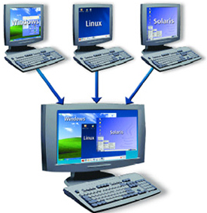
LINUX – SOFTWARE MANAGEMENT
Docente: Dott. Daniele Gobbo Modulo 3

Slide 2
DPKG (Debian and Ubuntu Based Distros)
Most applications on Linux are OpenSource.
We are provided with the source files of the application, and in order to run it on our platform, we have to either compile the sources or install it from a binary package.
A binary package in the Linux context is an application package which contains executables as opposed to source code.
The executables are the outcome of the compilation process. In this lecture will discuss how to manage the software applications on Ubuntu and other Debian based distributions like Linux Mint, MX Linux or Kali using dpkg.
Deb is the installation package format used by all Debian based distributions.
This is an archive that contains other files, including the executable application that
was already compiled.

Slide 3
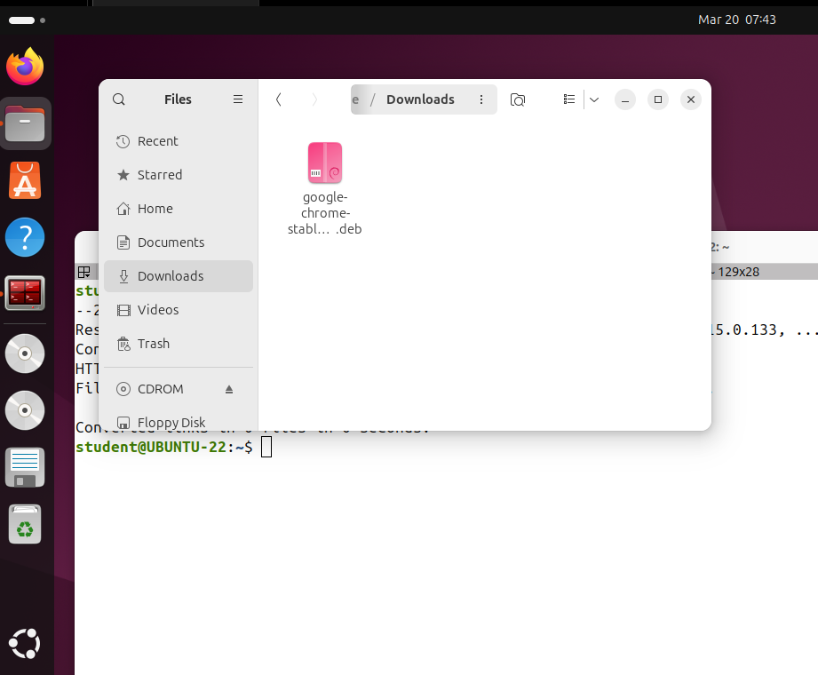
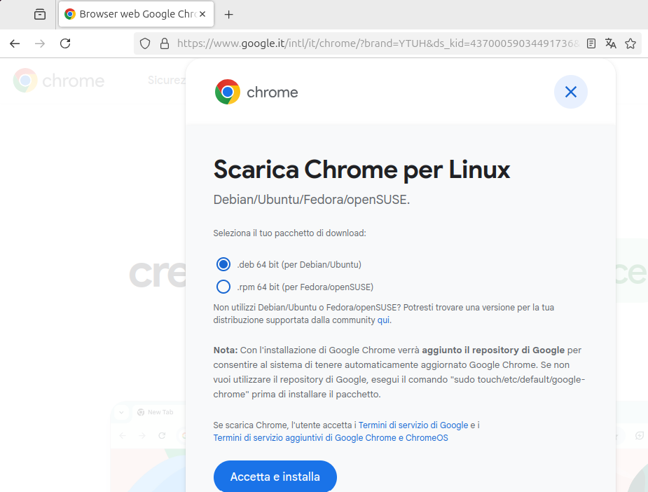
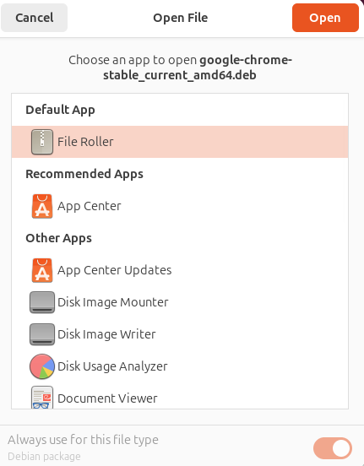
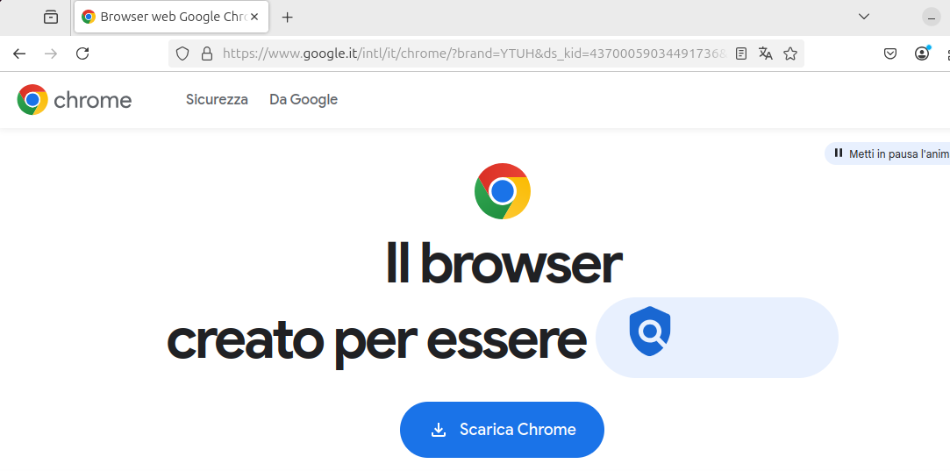
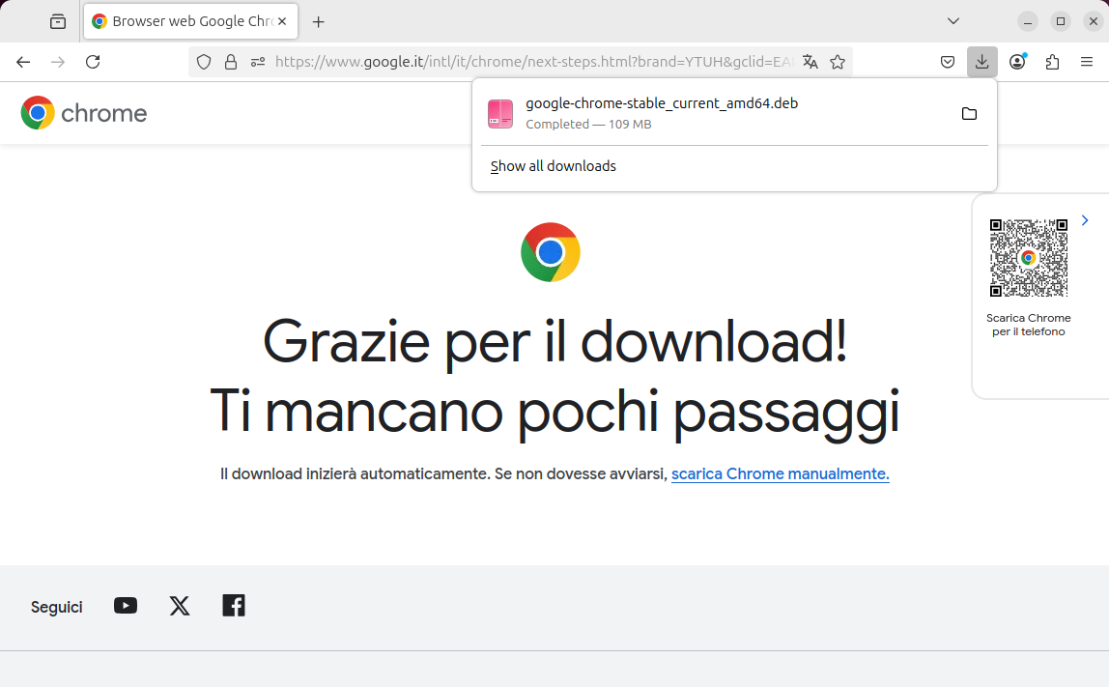
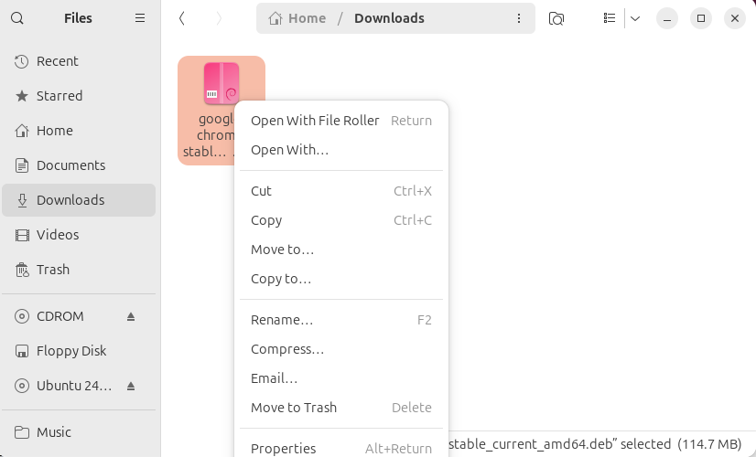
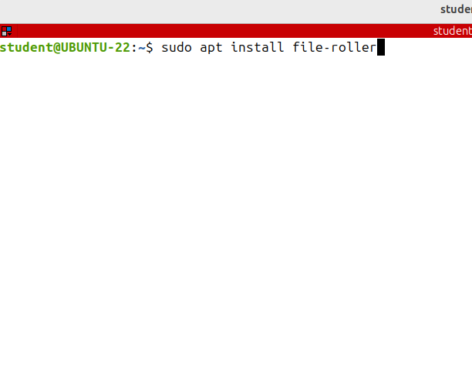
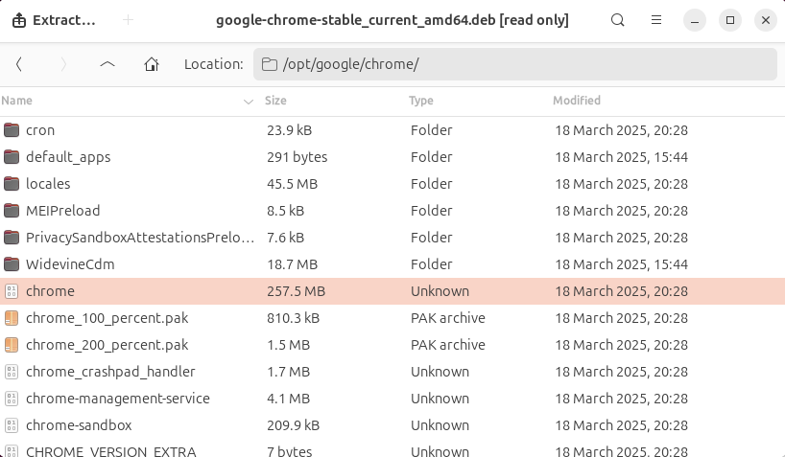
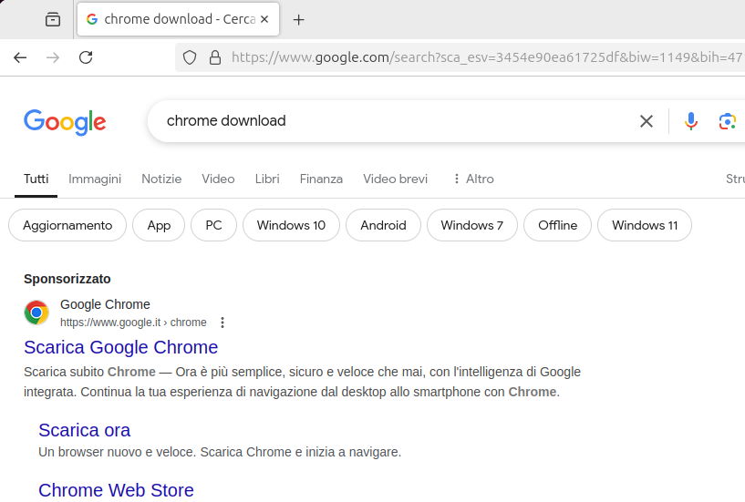
DPKG (Debian and Ubuntu Based Distros)
We want downloading Google Chrome, which comes as a deb package.
Instead of installing it I just want to see its contents.
I need to install a program to manage archives (like .zip, .rar, .tar.gz files) on Ubuntu system. The default archive manager in Ubuntu is called File Roller, but it's often referred to as Archive Manager in menus and descriptions.

Slide 4
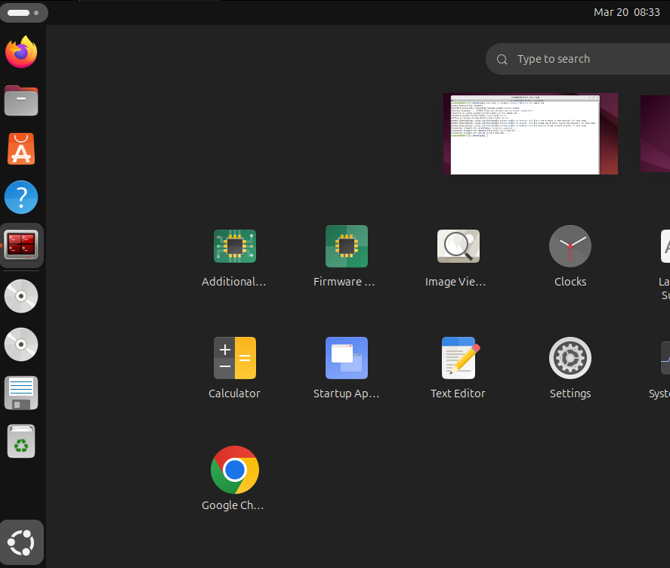
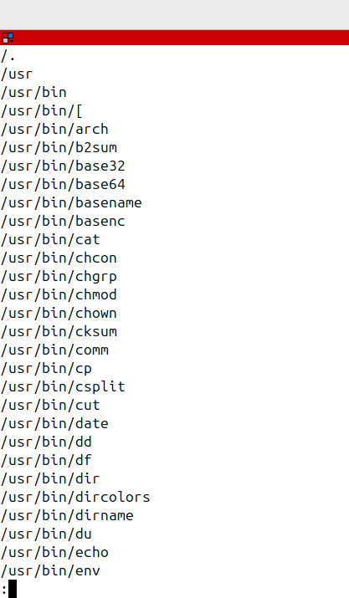
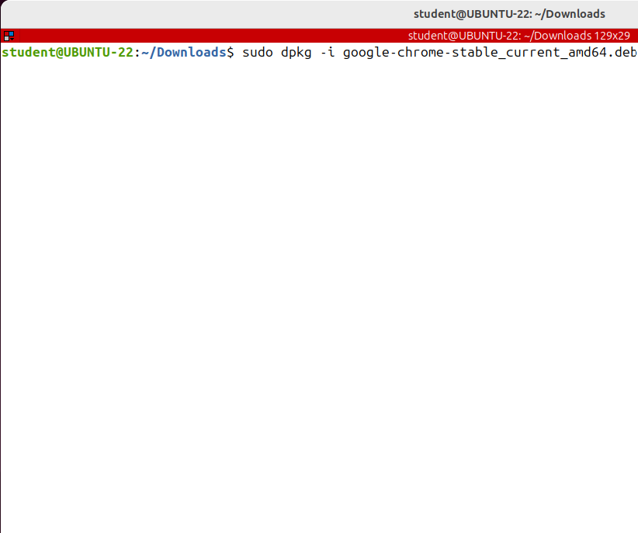
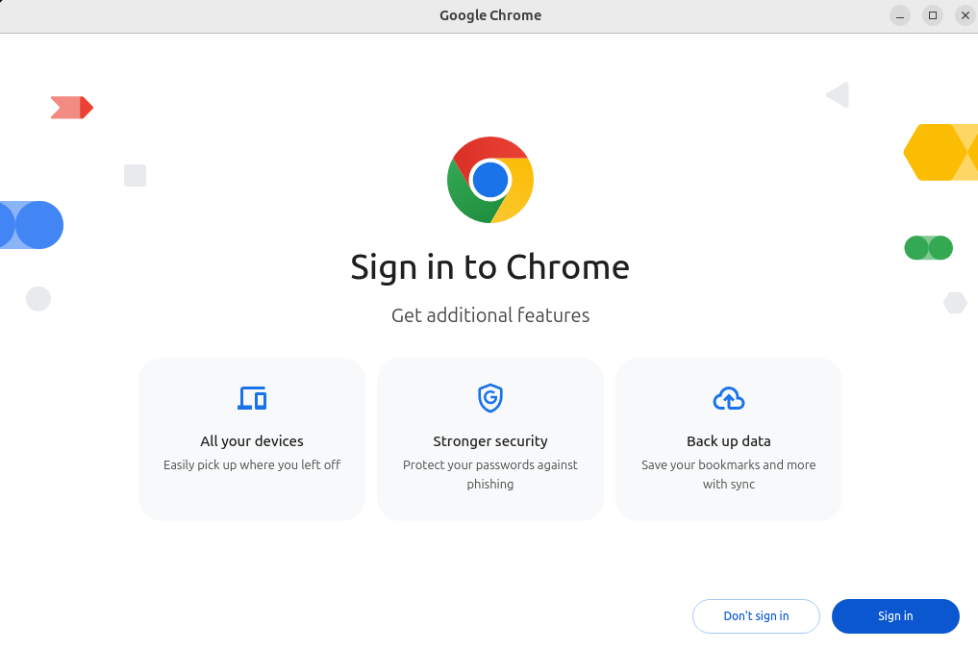
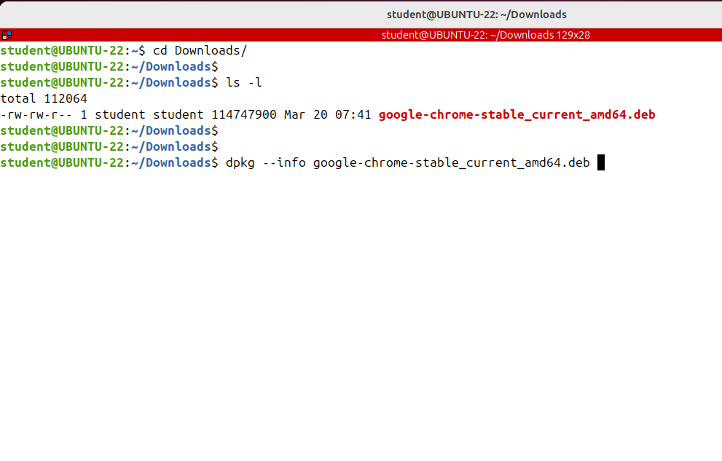
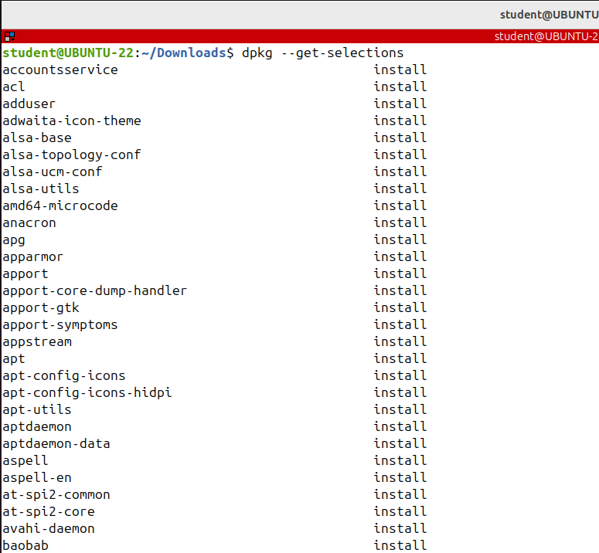
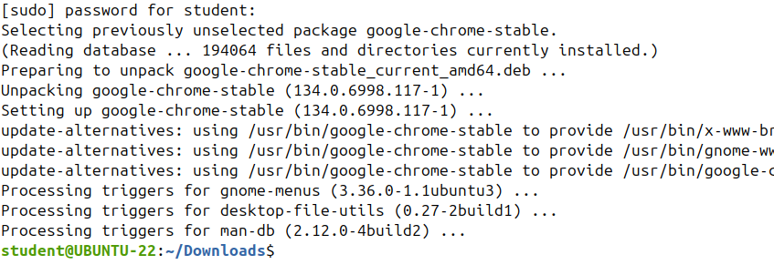
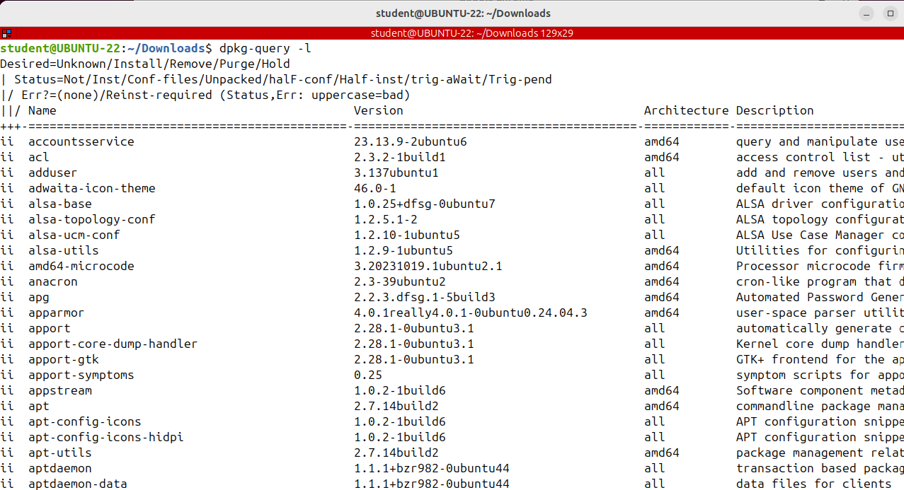
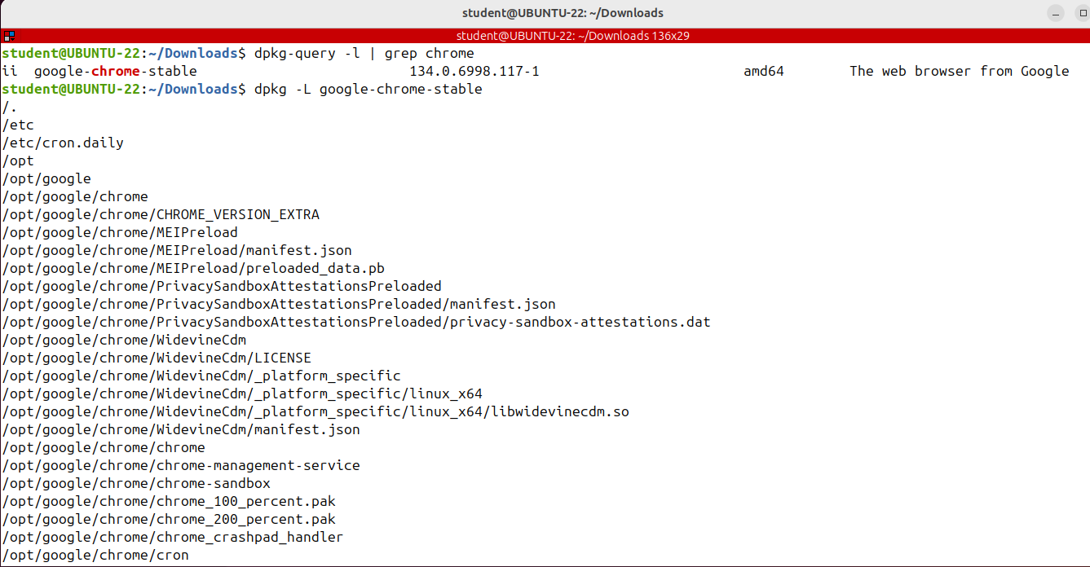
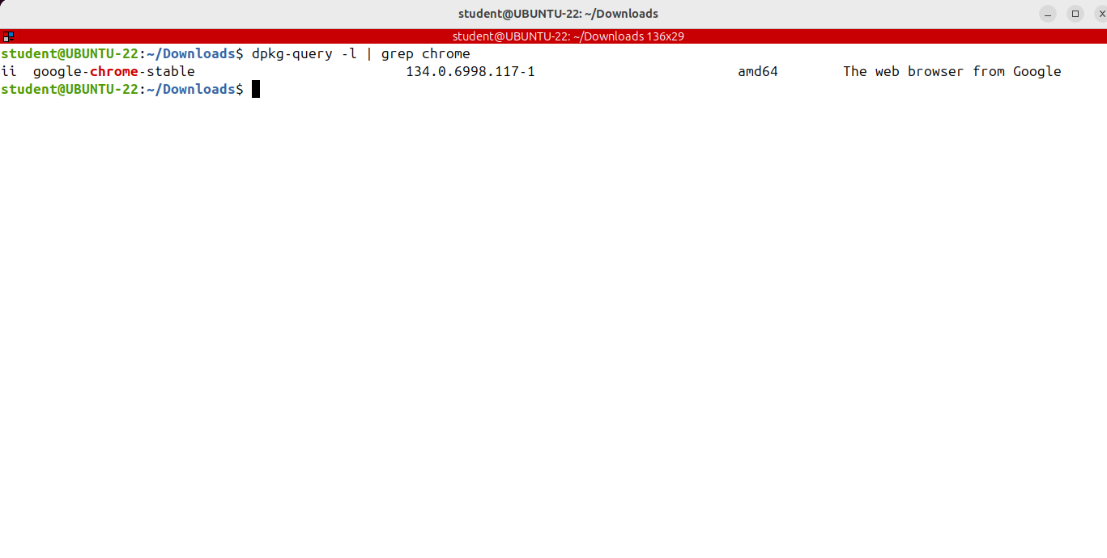
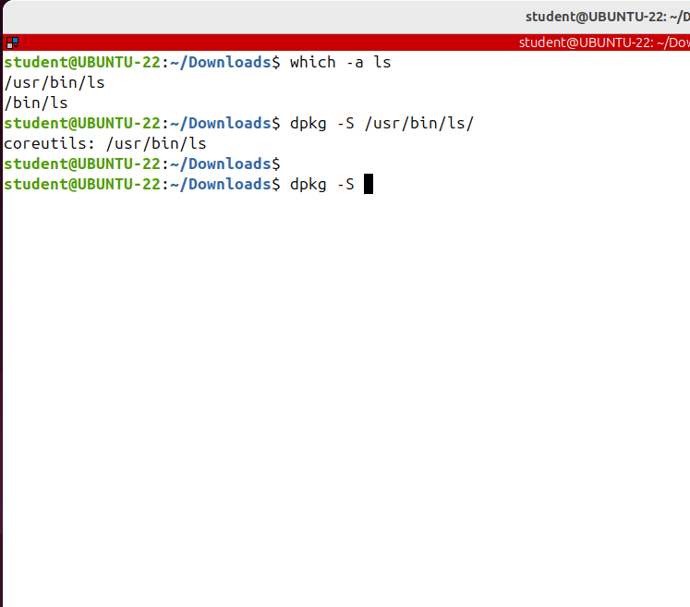
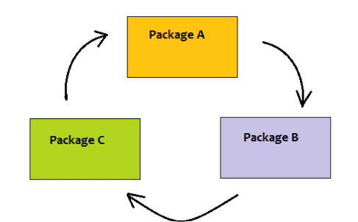
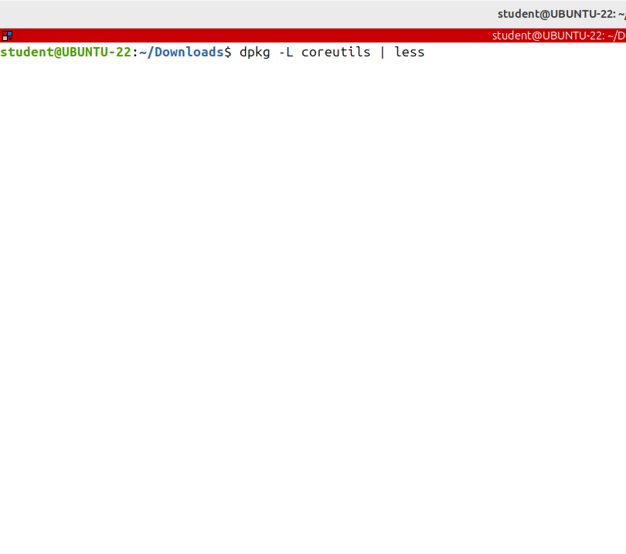
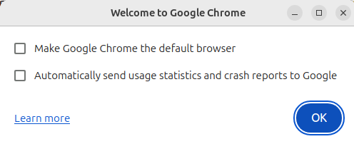
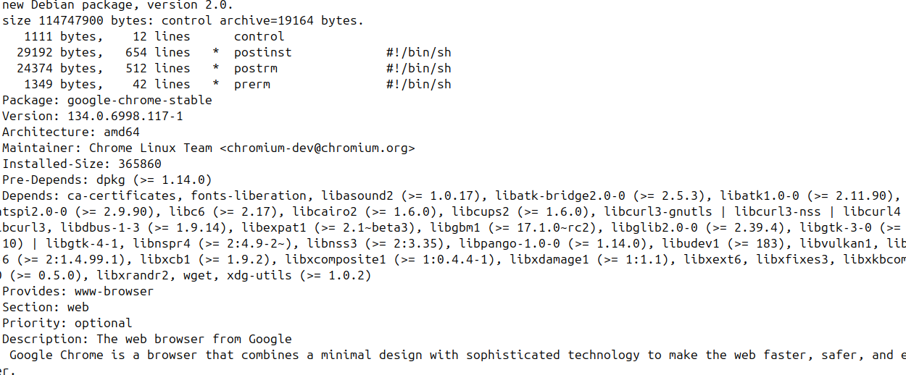
DPKG (Debian and Ubuntu Based Distros)
if you want to see to what package a specific file belongs to, then use the capital S option.
Suppose an important file got corrupted and you want to reinstall the package;
Let's see to which package the ls command belongs:
If you are to list all files installed on your system from a package run dpkg with the -L option and the package name.
if you want to see the package version of the architecture and the short description run dpkg -query with the -I option.
To get a list of all installed packages run dpkg --get-selections
Package management operations can be performed with different tools available, from the lowest level command dpkg to apt or graphical front-ends like Synaptic.
dpkg provides the low-level infrastructure for package management. The dpkg database contains the list of the installed software on the current system.
It can work with local .deb package files and does not know about repositories and does not solve dependencies like apt does.
Note that other advanced tools like apt will call dpkg behind the scenes.
So they are based on dpkg.
If you want to install more packages at once, you don't have to run thedpkg command multiple times, just provide all deb files as arguments to a single dpkg command.
This is especially useful if there's a circular dependancy.
package that contains the ls command is called coreutils
to see all the other files from this package run dpkg -L and the package name coreutils
I'm piping the output to less.

Slide 5
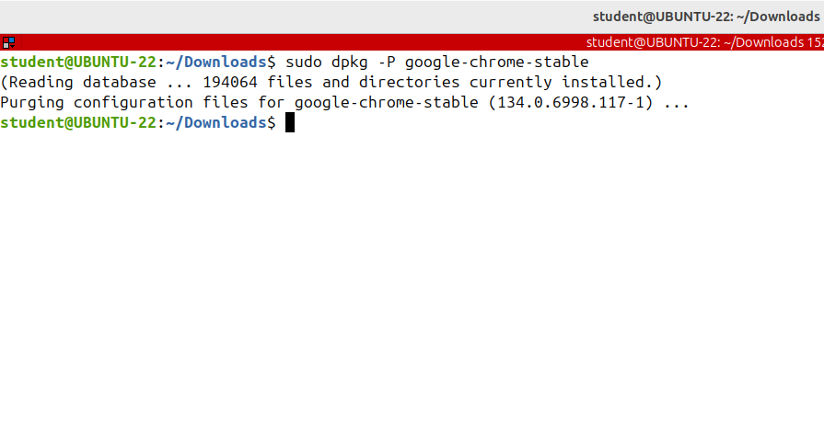
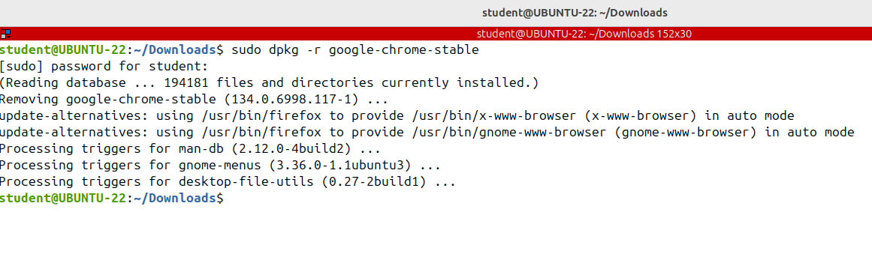
APT –ADVANCED PACKAGE TOOL
To remove an already installed package, use the -r or -- remove option and the ge name. Let's remove the Chrome browser so sudo dpkg –r an the name of the package google-chrome-stable
You've just learned the basics of package management using dpkg on Debian based distributions.
However dpkd is a low-level tool that neither works with repositories nor solves dependency problems.
The recommended way of managing packages on a Debian based system is to use the apt tool.
Note that the -r option does not remove the configuration file as well. If you reinstall the package you’ll have the same configuration.
If you want to remove both the application and the configuration files, use the capital P or --
purge option.

Slide 6
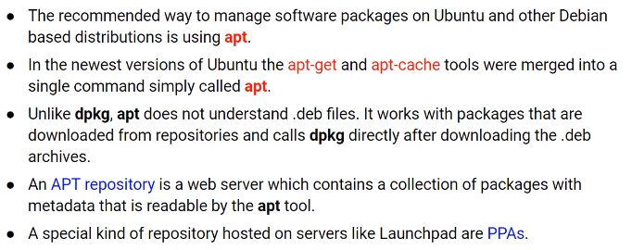
DPKG (Debian and Ubuntu Based Distros)
PPA stands for Personal Package Archives. Such a repository is maintained by people who are not official Ubuntu developers.

Slide 7
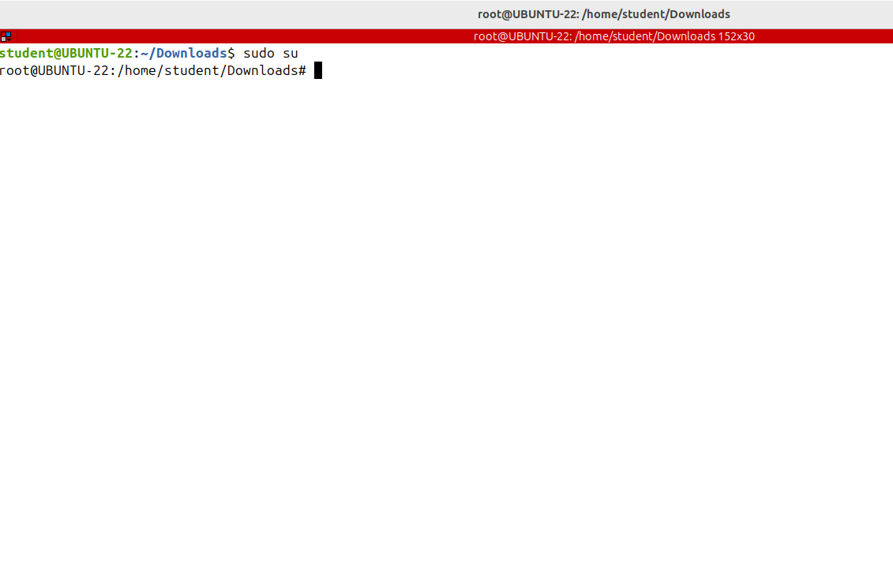
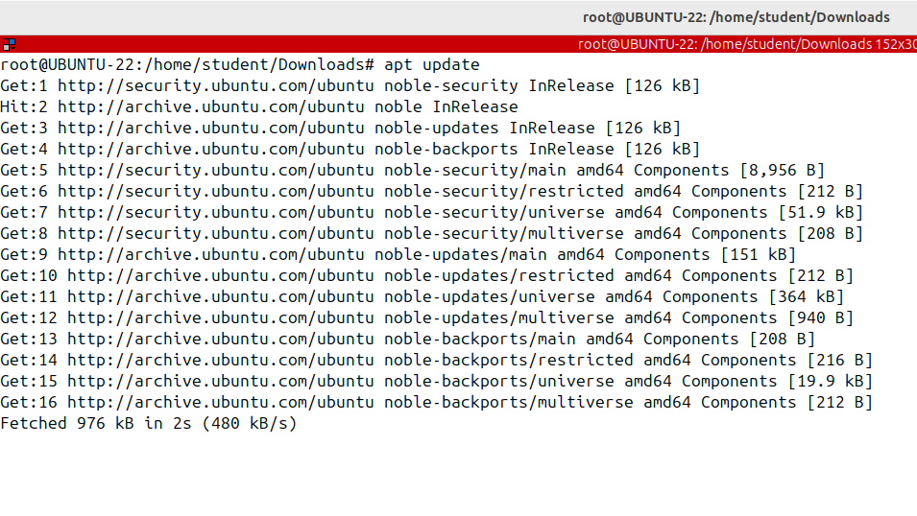
Using APT (Advanced Package Tool)
APT uses an index or a local database that holds records of available packages
from the repositories enabled in the system.
To update the package index run as root apt update; this will pull the latest changes from the apt repositories.
It's recommended to run this command each time before installing or upgrading new packages.
Note that the command doesn't install or update any software application.
It just updates an index.

Slide 8
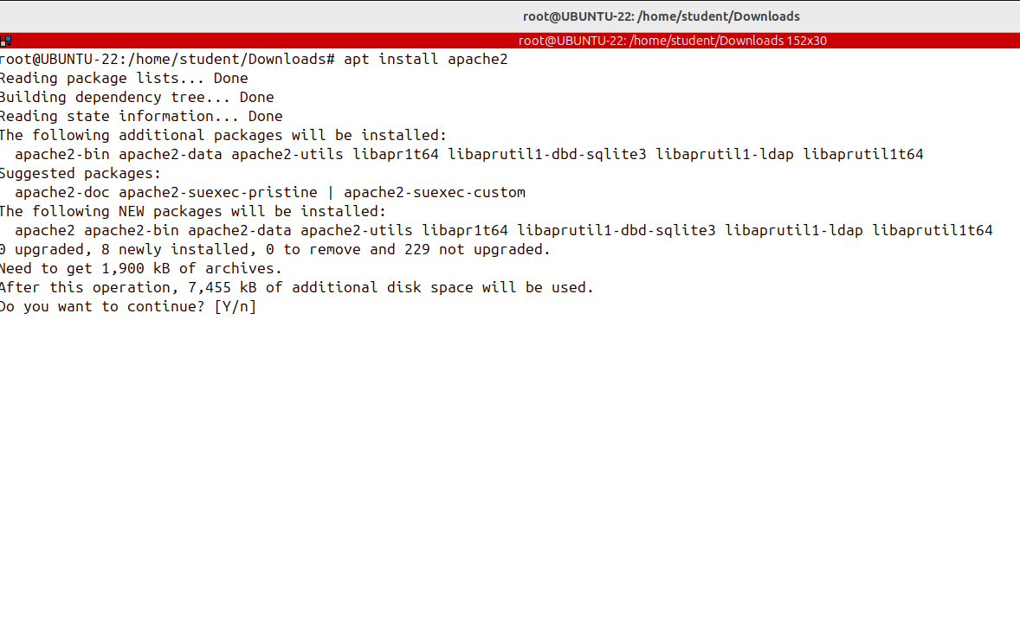
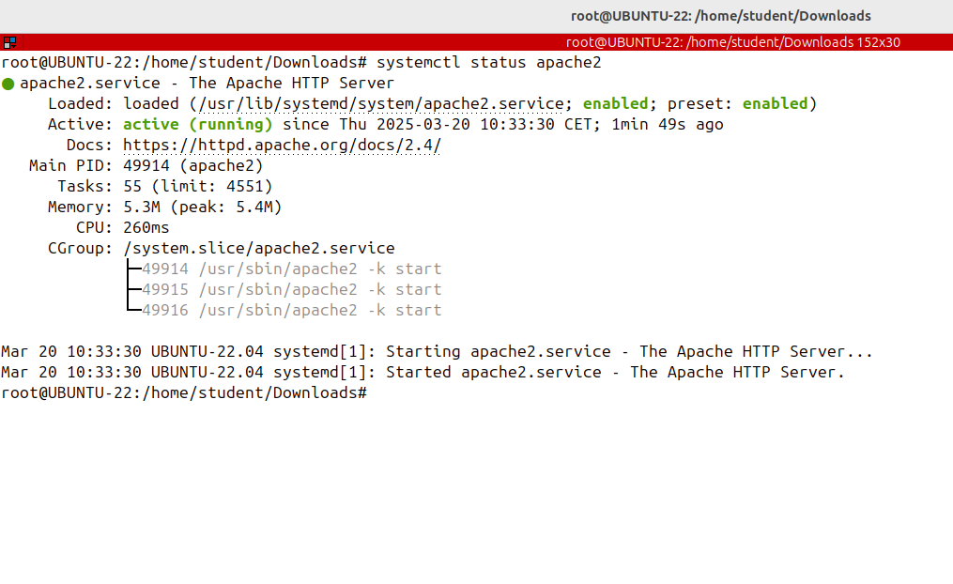
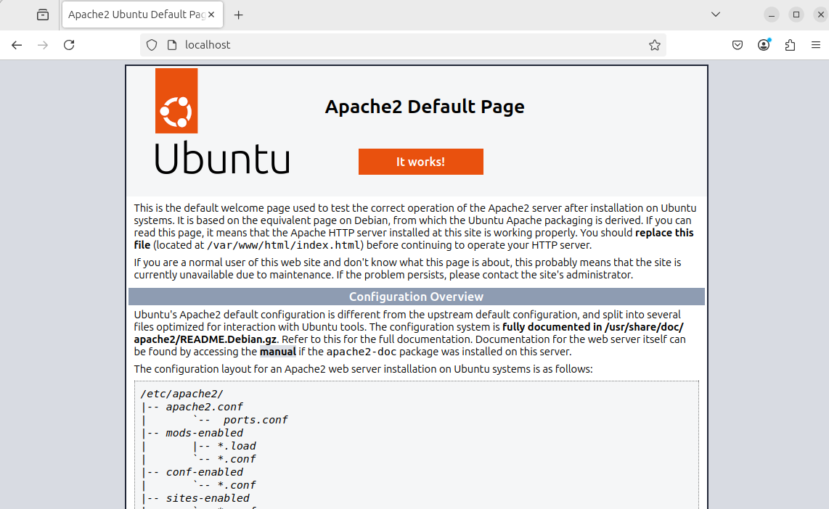
Using APT (Advanced Package Tool)
To install a new program run apt install and the package name. I'm installing the Apache Web server: apt install apache2
Apache2 being the name of the package.
It will install the specified package and all its dependencies. It's displaying a summary about its operation
and prompting for yes or no; if you write
Yes it will download and install those packages.

Slide 9
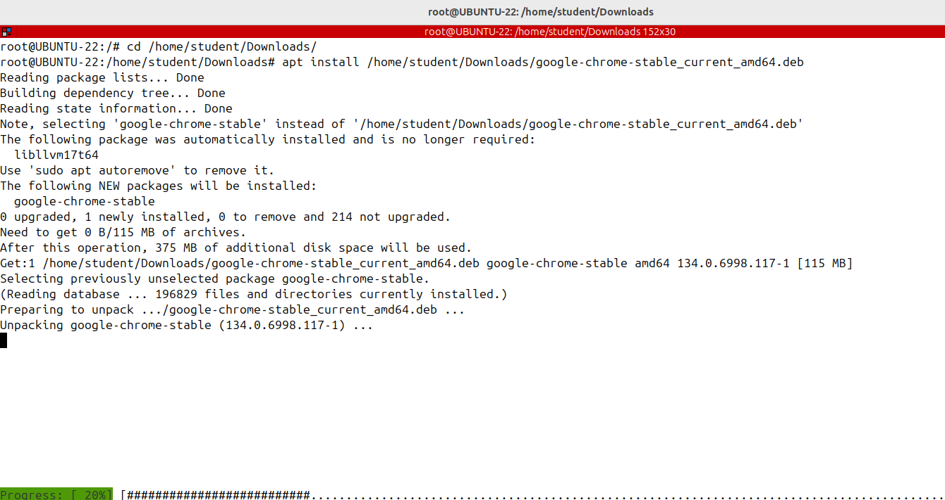
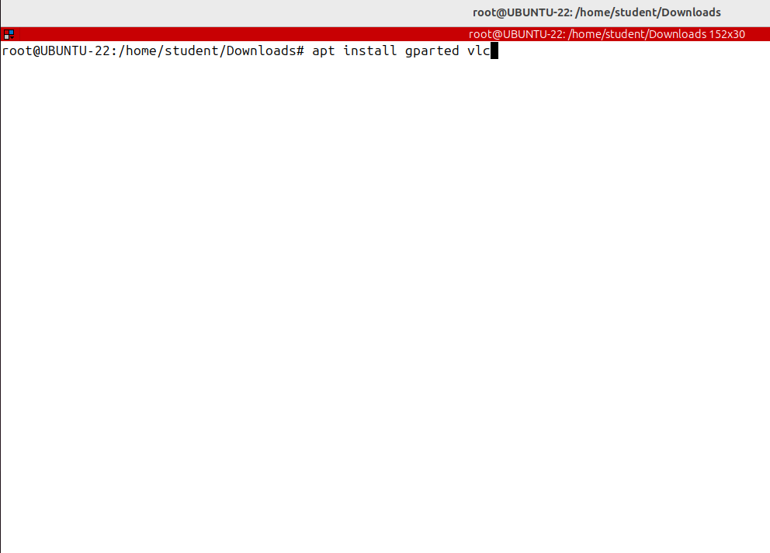
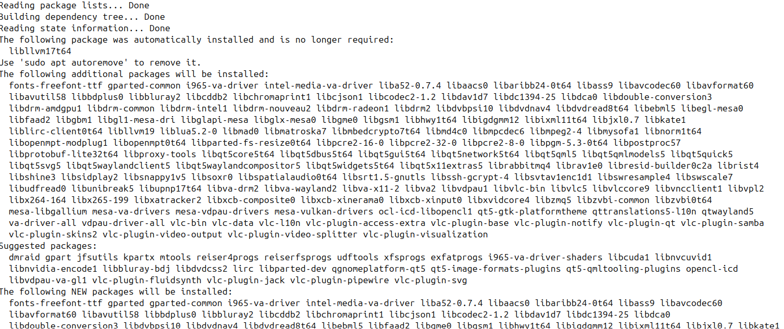
Using APT (Advanced Package Tool)
you want to install multiple packages with one, command specify them
as a space-separated list
Using apt, it's also possible to install a program from a local deb file, just run app install and provide the full path to the file as argument

Slide 10
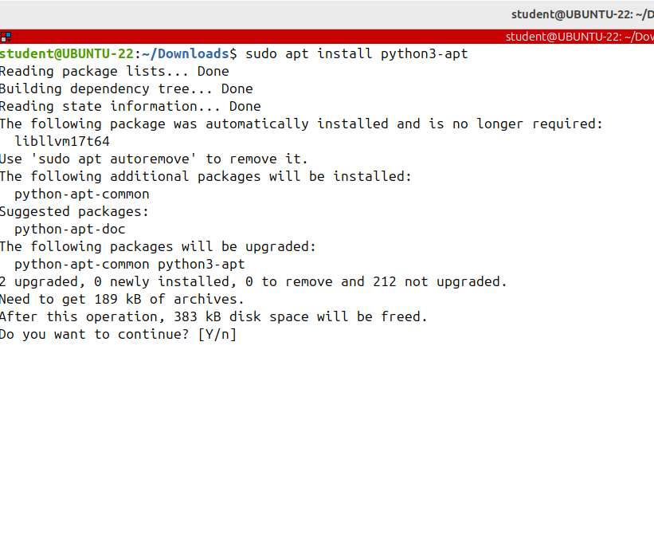
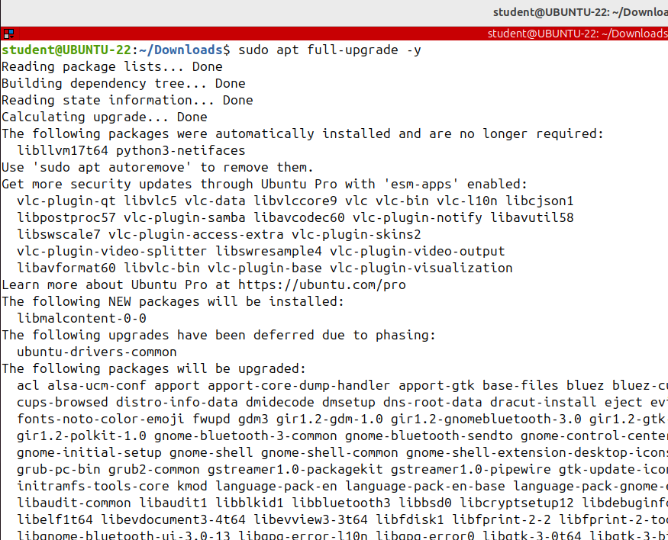
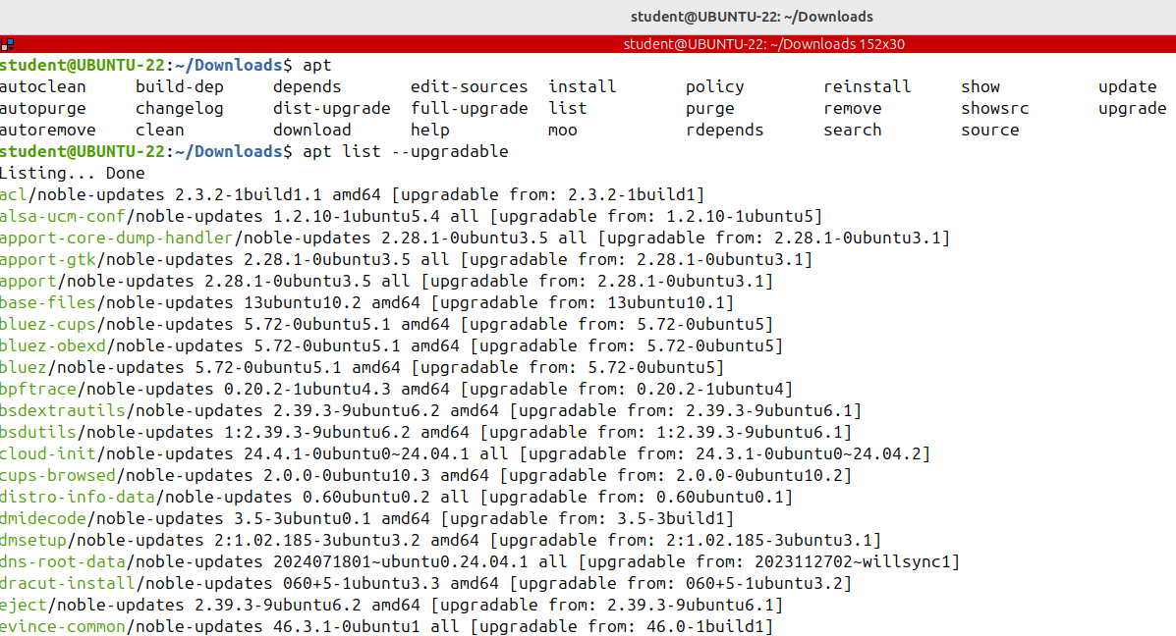
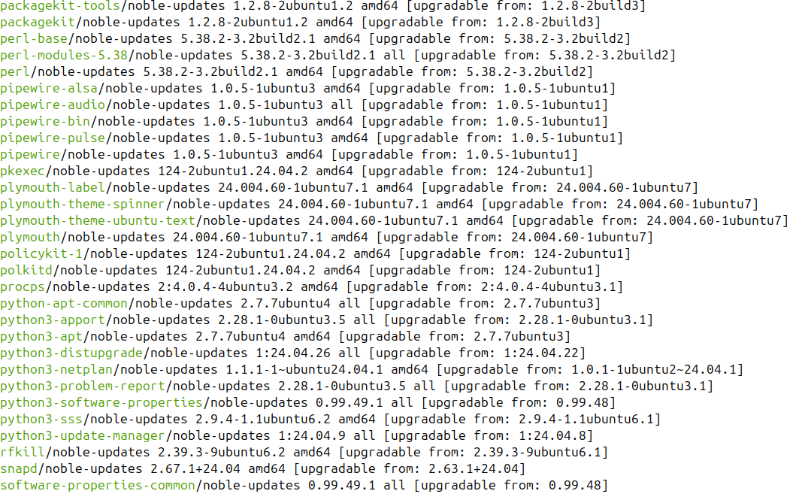
Using APT (Advanced Package Tool)
To get a list of all packages that can be upgraded run apt list --upgradable
If the package already exists apt install will upgraded to the latest version,
This will remove some installed packages if that is needed, to upgrade the whole system;
if you want to run this command from a Shell script, then pass the -y option, which means assume yes as answer to all prompts and run non interactively

Slide 11
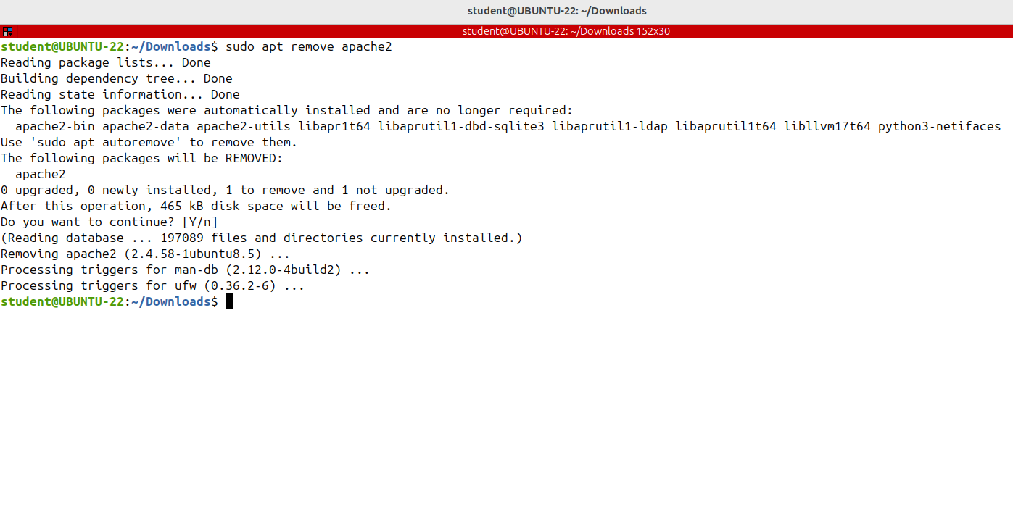
Using APT (Advanced Package Tool)
To remove uninstalled package apt remove and the package name
Provide multiple packages separated by spaces to remove them all.

Slide 12
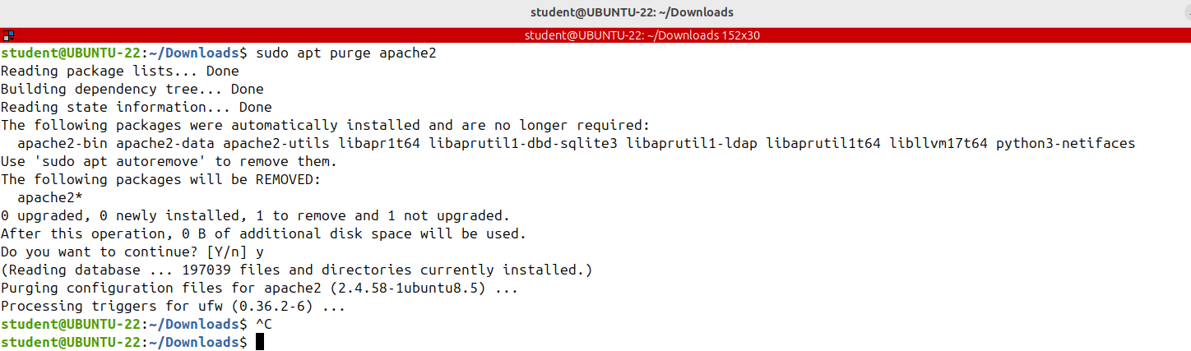
Using APT (Advanced Package Tool)
The remove command will uninstall
the given packages, but it may leave some configuration files behind.
If you want to remove the package, including all configuration files, use purge instead of remove.
sudo apt purge apache2
Whenever a new package is installed on the system, the package dependencies
will be installed too; when the package is removed, using apt remove or apt purge, the dependencies will not be removed as well.

Slide 13
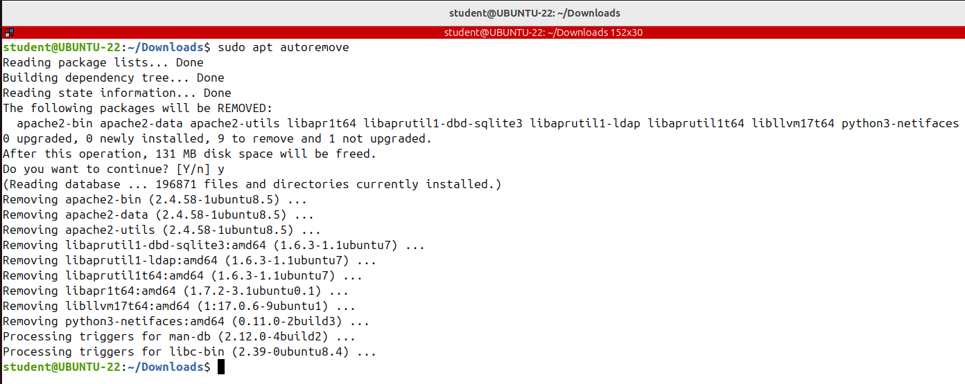
Using APT (Advanced Package Tool)
You can always remove these dependency packages since they are no longer used! To remove the unneeded
dependencies, run sudo apt autoremove.

Slide 14
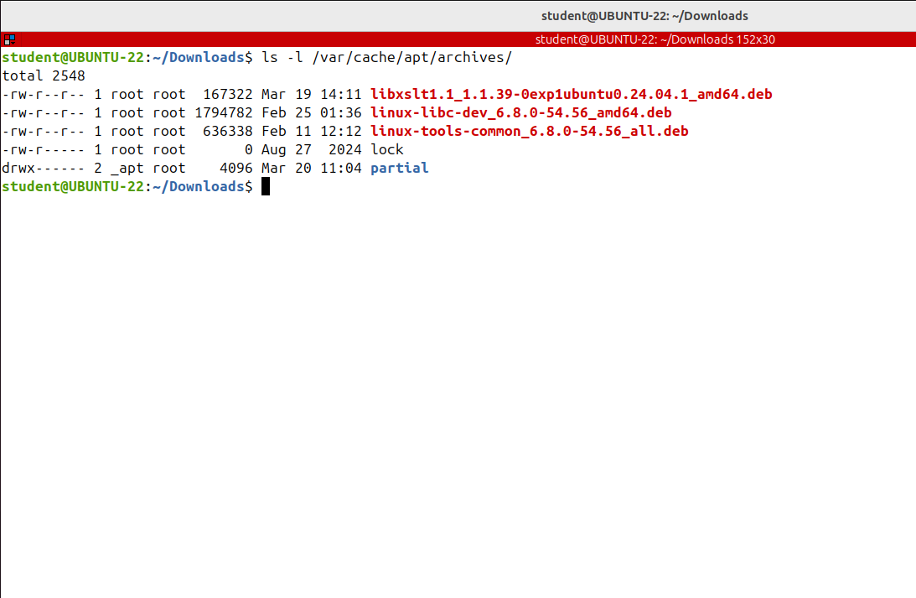
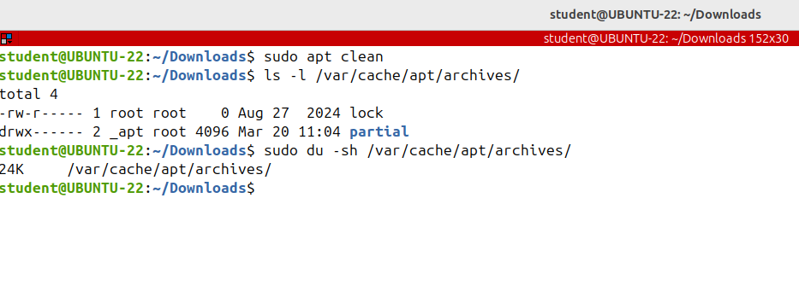
Using APT (Advanced Package Tool)
By default, Ubuntu keeps every package that has been downloaded and installed in a cache directory on the disk.
This is the cache directory:
/var/cache/apt/archives
This is the directory that contains all installed and upgraded packages.
To clear out the local repository of retrieved package files run apt clean.
It removes everything
Let's check the contents of the directory again; and it's empty.

Slide 15
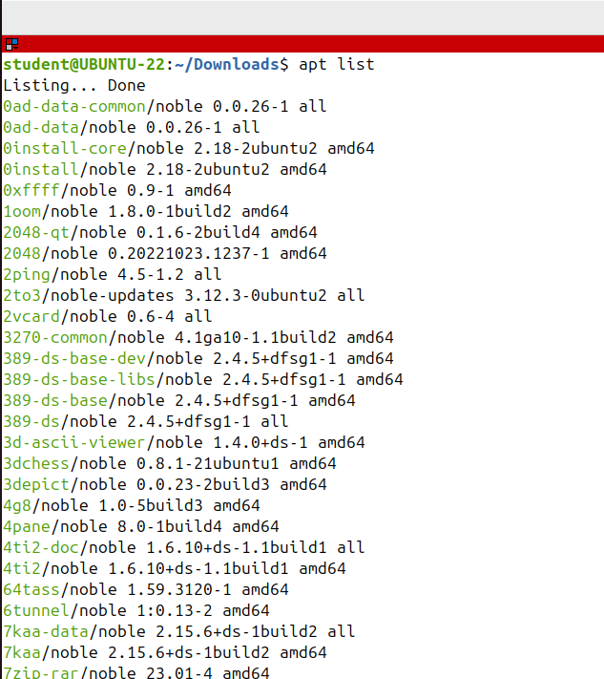
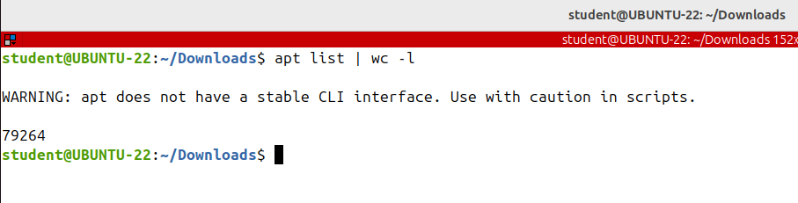
Using APT (Advanced Package Tool)
To list all available packages run apt list.

Slide 16
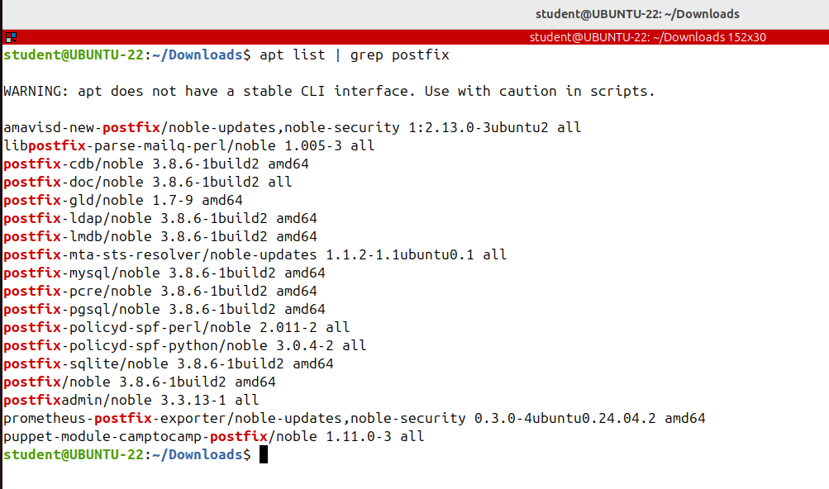
Using APT (Advanced Package Tool)
To search whether a specific package is available, filter the output with the grep command

Slide 17
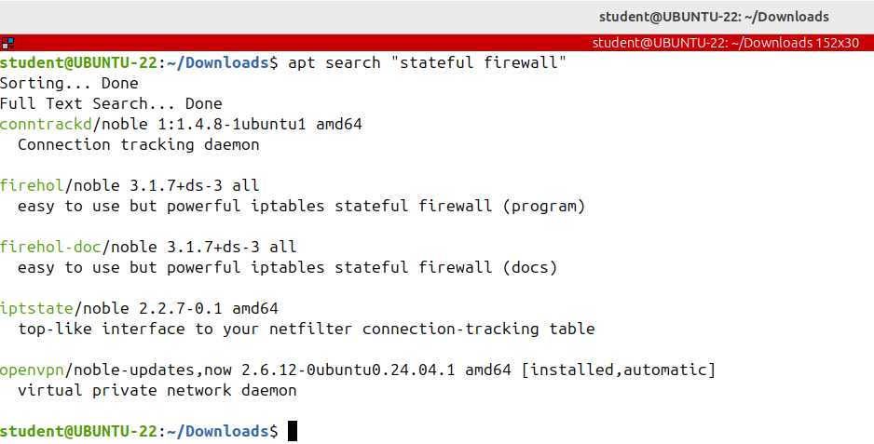
Using APT (Advanced Package Tool)
To find packages whose description contains a word or a phrase run apt search in the phrase between double quotes

Slide 18
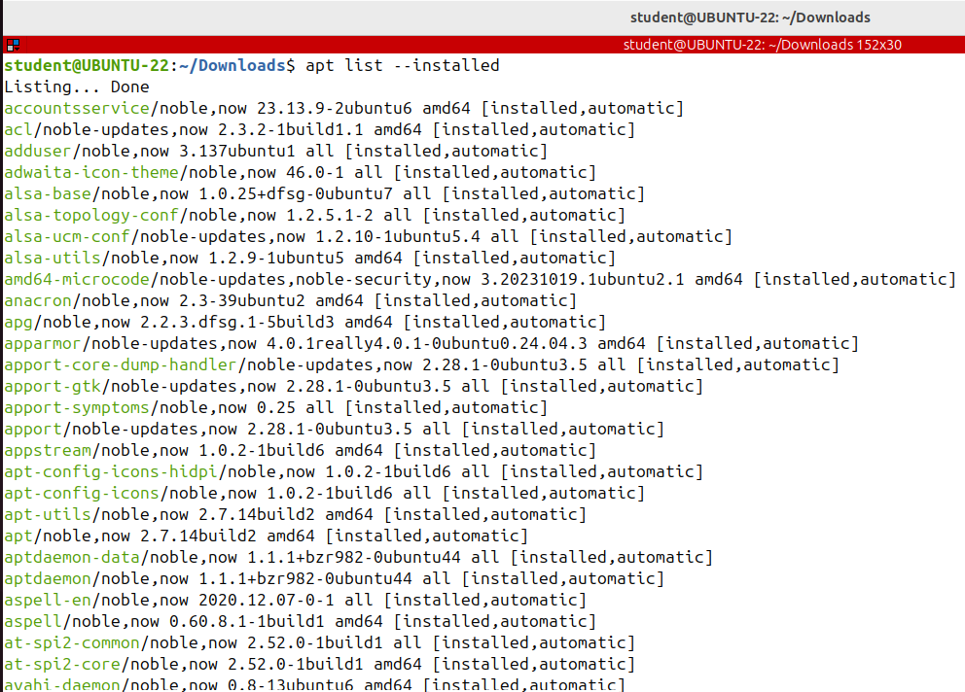

Using APT (Advanced Package Tool)
To get a list of only the installed packages add the - -installed option.

Slide 19

Using APT (Advanced Package Tool)
To find information about an available or uninstalled package including its dependencies, download size and the description of its contents run apt show and the package name

Slide 20



Using APT (Advanced Package Tool)
There are also graphical package managers, aptitude or synaptic being some of them. They enable you to install, upgrade and remove software packages in a user friendly way

Slide 21


COMMANDS

Slide 22









QUIZ TIME

